Slide 1
[Organisation] · PHASE E
Consolidated Gaps,
Solutions and Dependencies
Eighteen gaps, sixteen packages, twenty-three derived dependencies, and the three the schedule cannot satisfy
18 gaps · 16 packages · R814m · 23 derived dependencies
Draft 0.1 · October 2027

Slide 2
HOW THE DEPENDENCIES WERE FOUND
Nobody was asked to list them
If a building block in one package depends on a block in another, the packages depend on each other. Twenty-three edges fall out of fifty-six blocks.
Dependencies are derived, not asked for
If a building block in one package depends on a block in another, the packages depend on each other.
56 blocks, 23 edges
Nobody was asked to list programme dependencies. They fall out of the architecture.
Three verdicts, not two
Clean: the package starts after its prerequisite ends. Overlapping: it starts before but finishes after. Impossible: it finishes before its prerequisite does.
1 clean, 17 overlapping, 5 impossible
Overlap is normal in delivery and is not a failure. Finishing before the thing you depend on is.
Two domains agree independently
Two of the three impossible dependencies are expressed by a business building block and an application building block separately.
Modelled in different phases
That is a confirmation rather than a duplication, and it is why the finding is stated with confidence.
The overdue test is against today
A gap is overdue when the latest package addressing it has passed its end date.
As at October 2027
Five gaps are overdue and the Phase C and D artifacts show none of the five closed.
Overlap is normal in delivery and is not a failure. Finishing before the thing you depend on is.

Slide 3
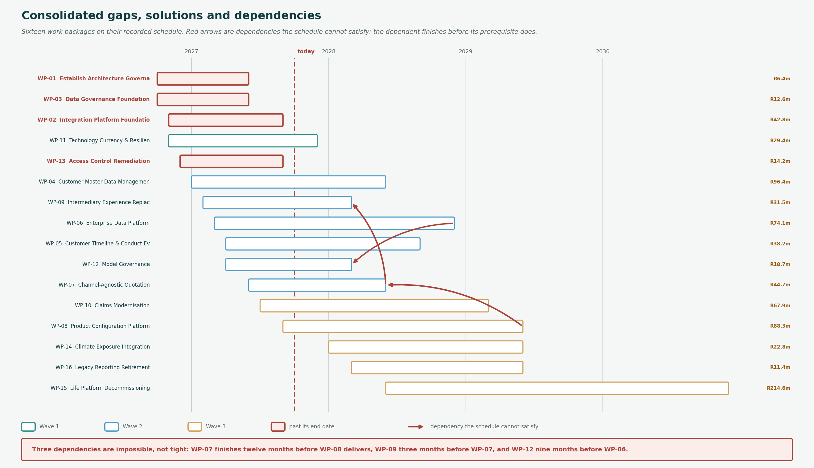
THE PROGRAMME
16 packages, R814m, as scheduled today
Red bars are past their end date. Red arrows are dependencies the schedule cannot satisfy.

Slide 4
IMPOSSIBLE
Three dependencies cannot be satisfied
Not tight — impossible. Each dependent package finishes before the thing it depends on exists.
WP-07 Channel-Agnostic Quotation
Quotation must rate against the product catalogue. WP-07 finishes twelve months before the catalogue exists.
Confirmed by ABB-06 depending on ABB-05, and independently by APP-BB-06 depending on APP-BB-05.
finishes 2028-06
Either WP-07 delivers quotation against product rules held in code, which is the problem it exists to solve, or it moves behind WP-08.
needs WP-08 Product Configuration Platform
which finishes 2029-06
WP-09 Intermediary Experience Replacement
The intermediary portal needs the quotation service. WP-09 finishes three months before it exists.
Confirmed by ABB-07 depending on ABB-06, and independently by APP-BB-07 depending on APP-BB-06.
finishes 2028-03
WP-09 also starts four months before WP-07 begins. It is the furthest ahead of its own prerequisites of any package.
needs WP-07 Channel-Agnostic Quotation
which finishes 2028-06
WP-12 Model Governance
Model governance needs the analytical platform to register and monitor models against. WP-12 finishes nine months early.
Expressed by ABB-12 depending on ABB-10.
finishes 2028-03
A model register with no platform to observe is a spreadsheet, which is the position the estate is in today.
needs WP-06 Enterprise Data Platform
which finishes 2028-12
Two of the three are confirmed independently by a business building block and an application building block. Two domains agreeing, modelled in different phases.

Slide 5
RECONCILIATION
Five gaps are already overdue
The latest package addressing each has passed its end date, and the Phase C and D artifacts show none of the five closed.
GAP-06
No managed integration layer
WP-02
ended 2027-09
~60 point-to-point interfaces and no API gateway.
Critical
GAP-13
No architecture repository
WP-01
ended 2027-06
Architecture content held in project sites and personal drives.
Critical
GAP-14
No architecture governance forum
WP-01
ended 2027-06
No body can approve or reject an architecture proposal.
Critical
GAP-04
No data ownership register
WP-03
ended 2027-06
No named business owner for customer or product data.
High
GAP-17
Generic accounts on legacy
WP-13
ended 2027-09
Shared accounts persist on the mainframe for batch and support access.
High
O30 records a status of Approved, which is an approval state and not a delivery state. There is no way to say a package delivered, partly delivered or slipped.

Slide 6
FINDINGS
What the consolidation shows
Three dependencies cannot be satisfied by the schedule as it stands
WP-07 finishes twelve months before WP-08 delivers what it needs. WP-09 finishes three months before WP-07. WP-12 finishes nine months before WP-06.
These are not tight, they are impossible: the dependent package completes before the thing it depends on exists. Each needs either a resequence or an explicit statement of what it will deliver without its prerequisite, and the second is how a package quietly delivers half of what was approved.
Five gaps are past the end date of the package meant to close them, and the architecture shows none closed
GAP-13 and GAP-14 (both Critical) under WP-01, GAP-06 (Critical) under WP-02, GAP-04 under WP-03, GAP-17 under WP-13. R76m of packages past their end date.
The register records a status of Approved, which is an approval state and not a delivery state. There is no way in the repository to say a package delivered, partly delivered or slipped, and no relation between a gap and evidence it was closed. Phase E cannot plan the next wave against an unreconciled one.
Twelve building blocks are gaps the gap register does not contain
Five data, four application, three technology. None appears in O29 and none has a work package.
A gap register built from architecture domains found eighteen gaps. A building block register built from the same architecture found twelve more mechanisms that nothing funds. They are the same kind of thing recorded in two places with different coverage, and the twelve are invisible to any roadmap driven off O29 alone.
Only one of twenty-three dependencies is cleanly sequenced
Seventeen overlap, which may be fine, and five are impossible, which is not.
The seventeen overlapping edges each need a stated assumption about what the prerequisite delivers early and when. None currently carries one, so the difference between a reasonable overlap and an impossible one is being decided implicitly by whoever plans the sprint.
Every dependency here was derived and none was asked for
Twenty-three edges fell out of the Depends On column of fifty-six building blocks.
No workshop was held and no project manager was surveyed. If the architecture is modelled properly the programme dependencies are already in it, which is the strongest argument this engagement has made for keeping the building blocks in the repository rather than in documents.
Every dependency here was derived from the architecture. If the building blocks are modelled properly the programme dependencies are already in them.

